Slide 1
VINTAGE BITES
“People come here as Guests and leave as Friends”
“We serve the best Vintage Foods”
“We welcome You”

Slide 2
CONTENTS
1.
PROBLEM SPECIFICATION
2.
CONCEPT DEVELOPMENT
AND CONTENT PLANNING
3.
USER INTERFACE DESIGN
4.
TESTING

Slide 3

PROBLEM SPECIFICATION

Slide 4
In a places where local restaurants are not able to expand their businesses due to:
Outdated ways of promoting though FLYERS and CARDS.
Limited to a fixed range of locality .
Inefficient way of booking tables through phones.

Slide 5

CONCEPT DEVELOPMENT
AND
CONTENT PLANNING

Slide 6
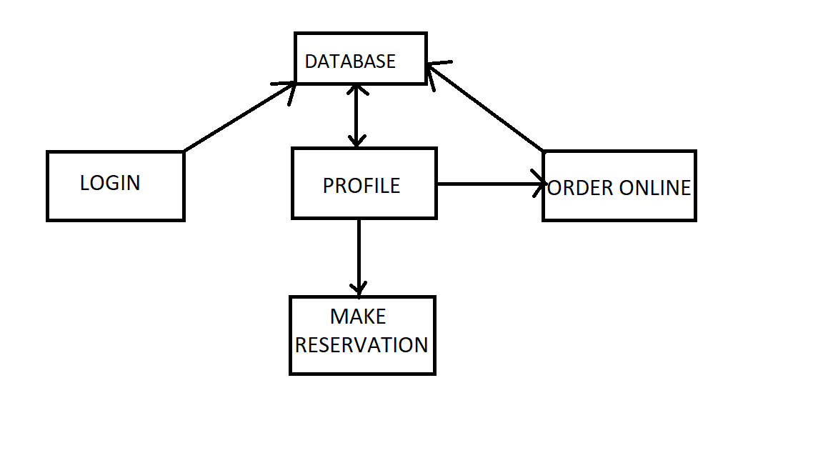
CONCEPT DEVLOPMENT

Slide 7
CONTENT PLANNING
USER -NAME
EMAIL ID
PHONE NUMBER
PREFRENCES

Slide 8

USER INTERFACE DESIGN

Slide 9
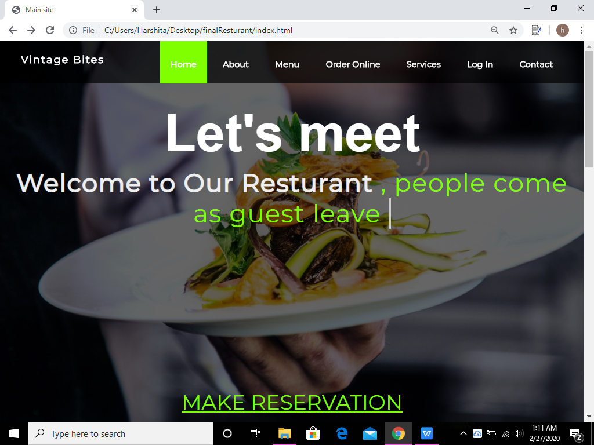
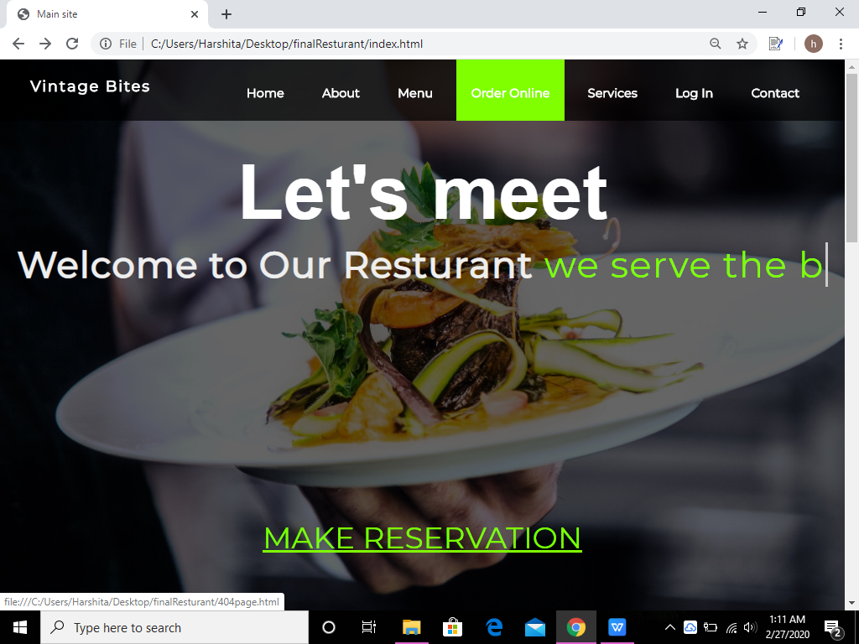
This is made by using type js. Its has 3 statement consecutively
Index Page Layout:

Slide 10
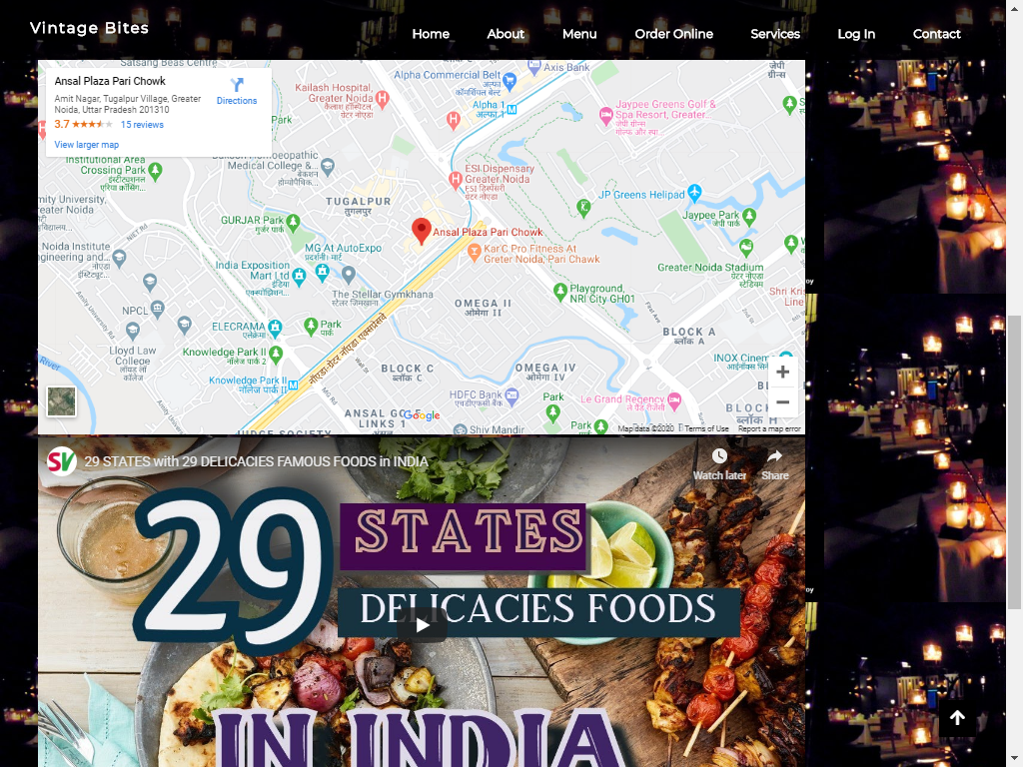

Slide 11
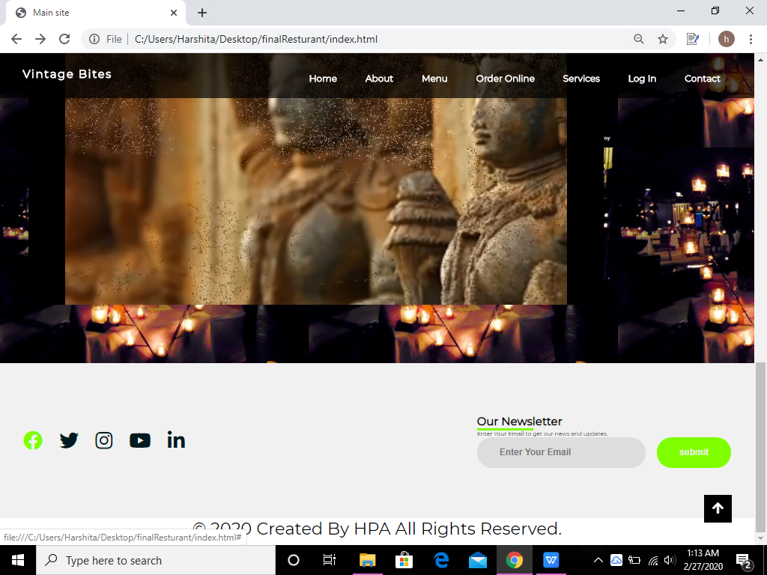
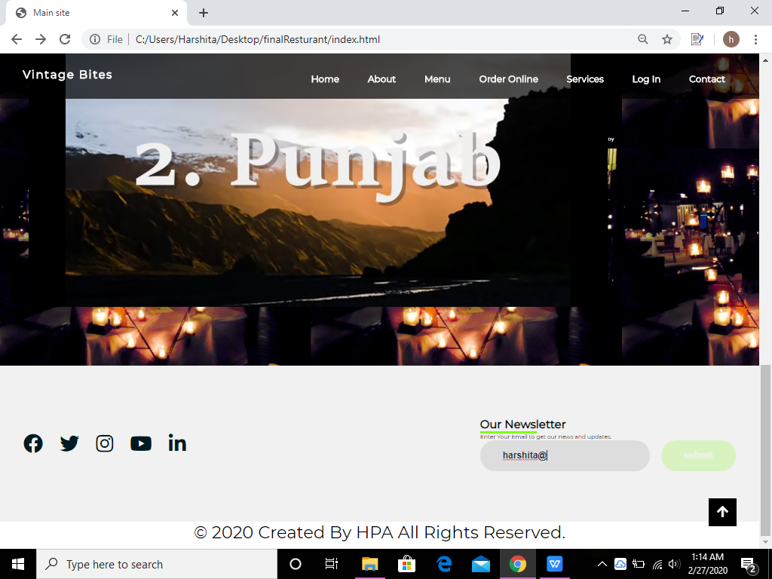

Slide 12
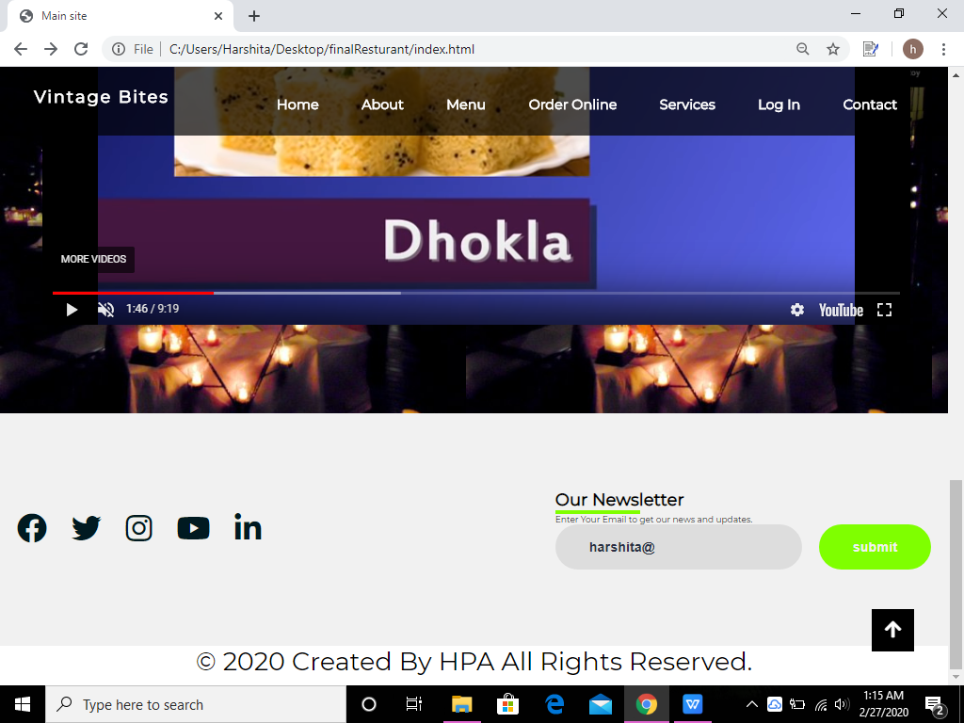
This is scroll up button when you will click this it will take up at the top of website .This is made usig Javascript.

Slide 13
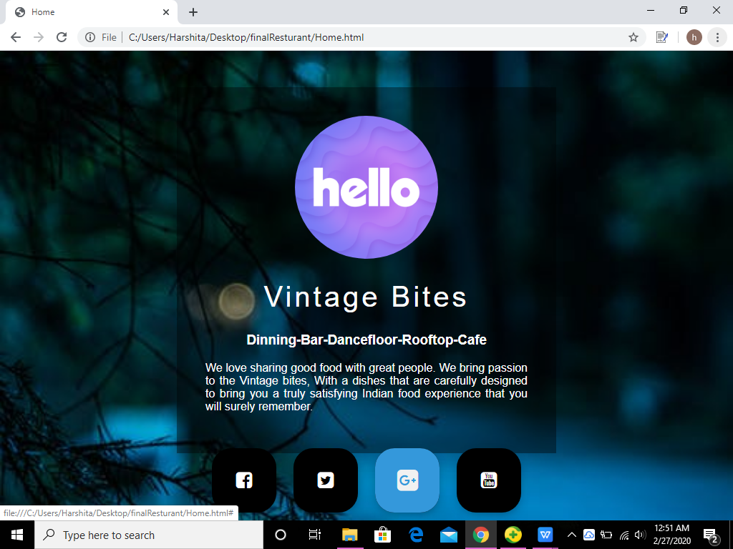
Home Page Layout:

Slide 14
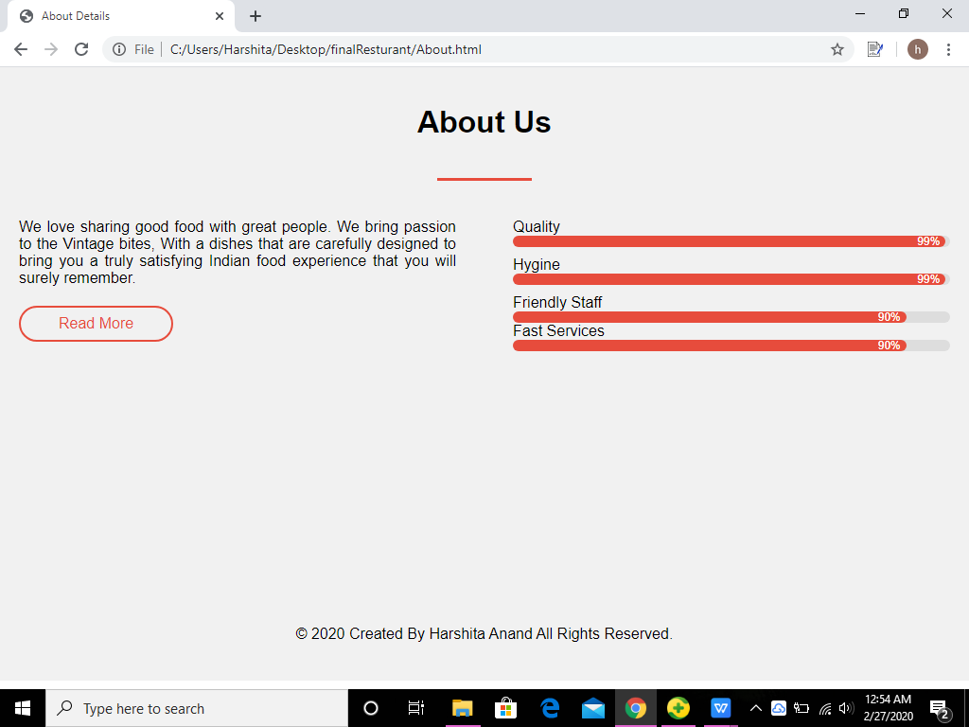
About Page Layout:

Slide 15
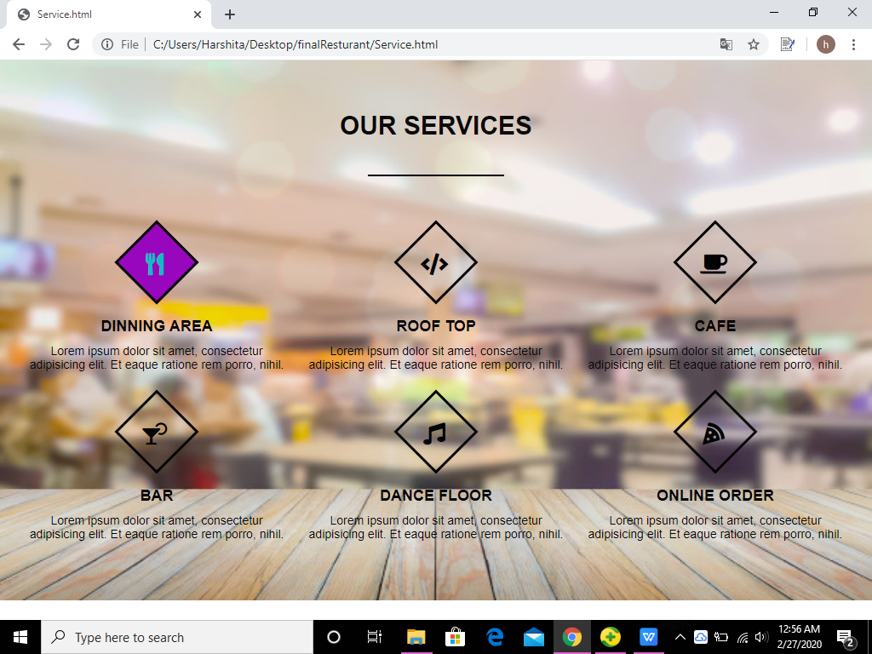
Service Page Layout:

Slide 16
4
TESTING

Slide 17
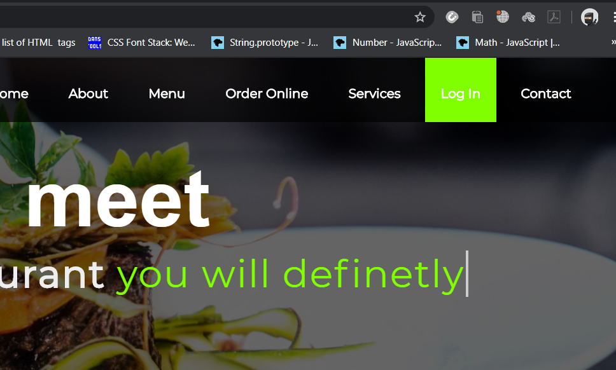
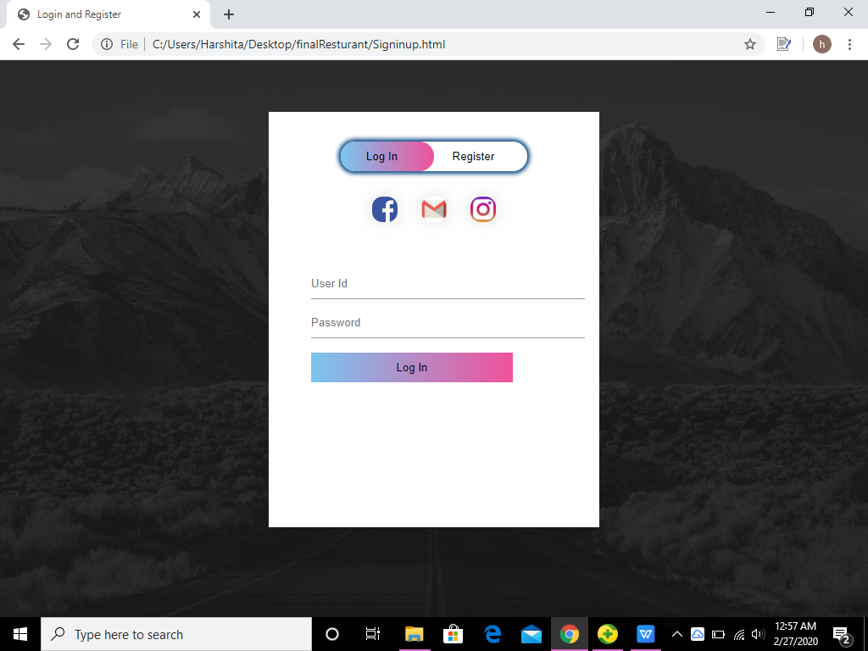
On Click Log in

Slide 18
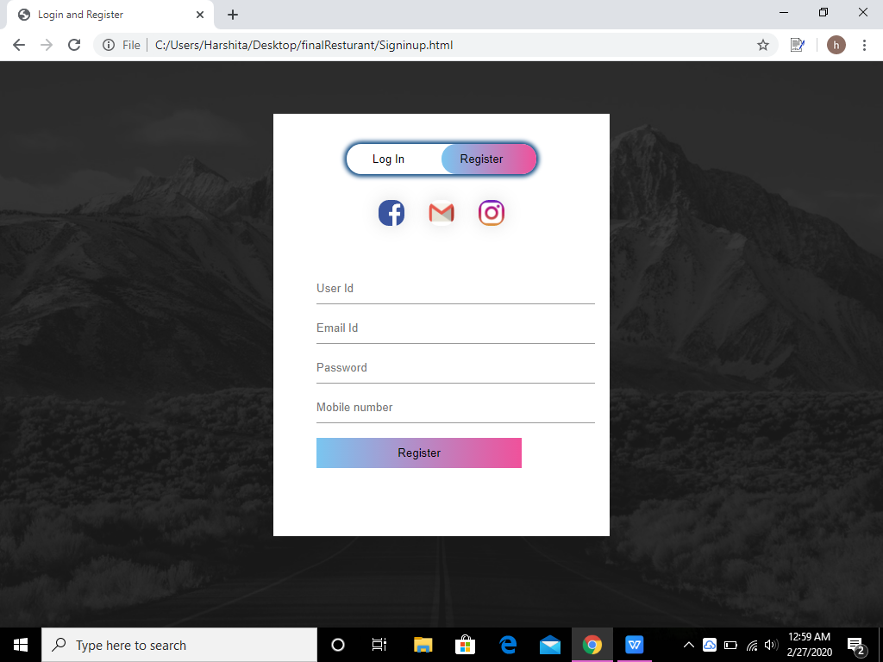
Register Page Layout:

Slide 19
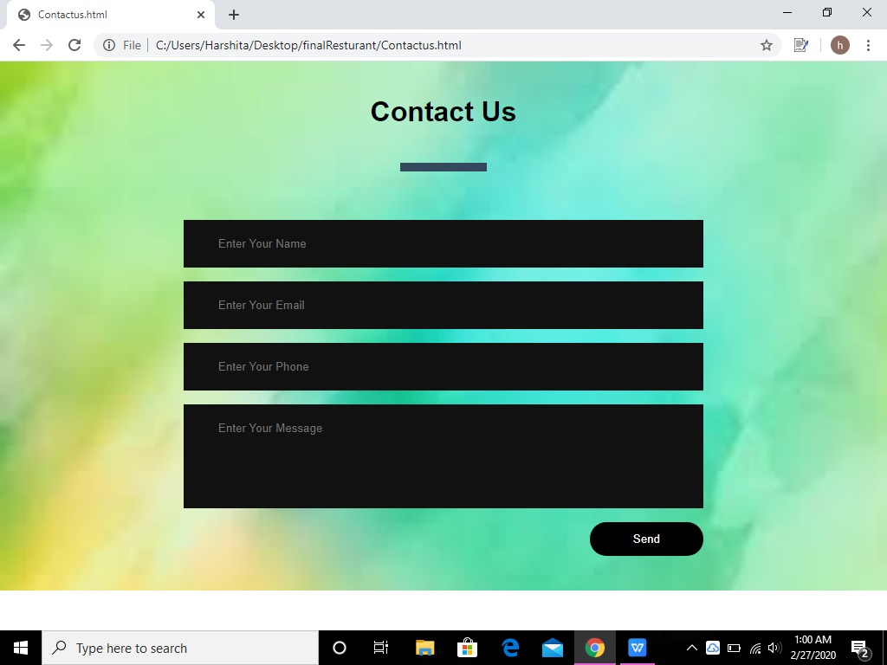
Contact us Page Layout:

Slide 20
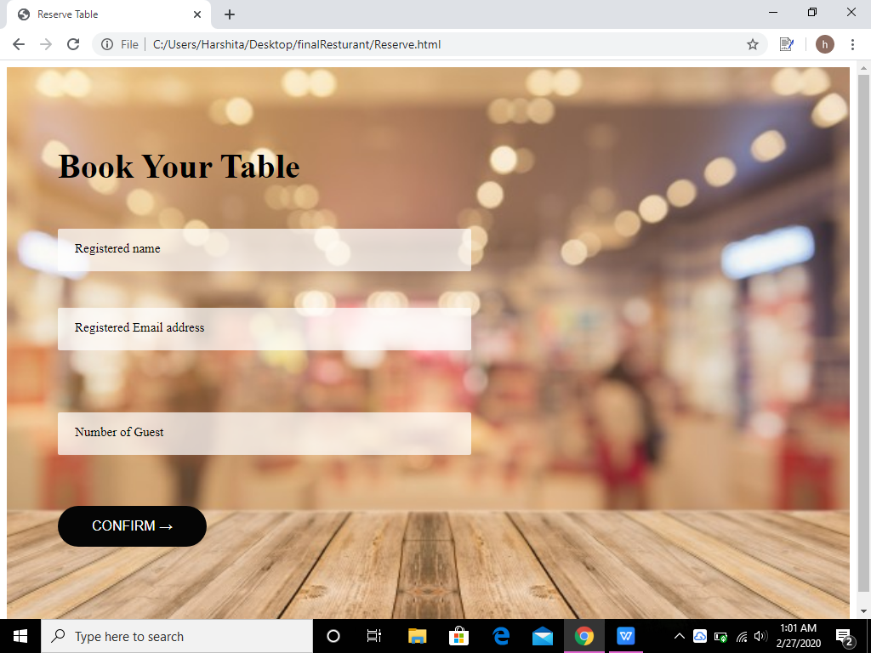
Make Reservation Page Layout:

Slide 21
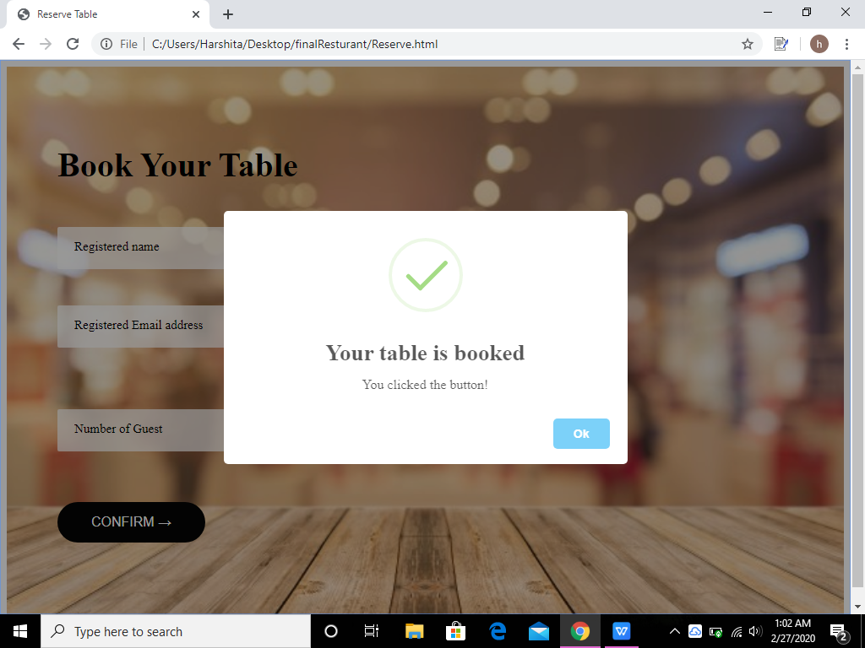
On clicking confirm in book your table:

Slide 22
THANK YOU

